Slide 1
Beginning Junior Infants
“Mol an óige agus tiocfaidh sí.”

Slide 2
Welcome!
Welcome to all parents and guardians.
Your child is finally ready to embark on their exciting journey into formal education.
Today’s presentation is here to inform you about what your child will learn in school, what kind of homework to expect, and practical advice to help you support your child as best as you can through their first year of school.

Slide 3
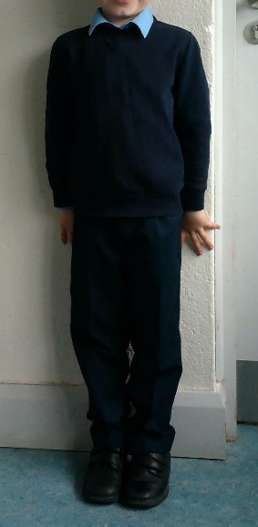
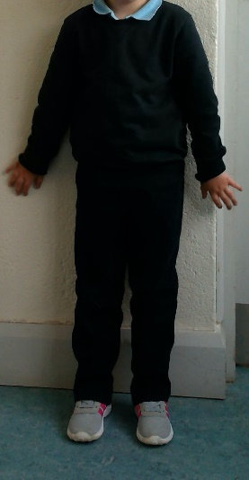
School Uniform
Navy Jumper/Cardigan
Light blue shirt/ t-shirt
Navy trousers/skirt/pinafore
Runners/ Shoes
Label all uniform items please

Slide 4
Preparation for School
Please speak positively about school.
Read books and discuss stories with your child.
Take trips to your local library.
Engage in fine-motor control activities: Threading, making jigsaws, play dough, fastening buttons, scissors etc.
Show your child how to put on/take off their coat (buttons/zip).
Label all belongings (especially jumpers and track suit tops).
Practice hand sanitising and hand washing.
Shoes - Velcro/no laces if possible.

Slide 5
Lunch
Break time: 10.50 - 11:00 & Lunch time: 12:30 - 13:00
10 minutes inside eating lunch 12.30-12.40
Not too much lunch, as it takes a long time to eat and children can get overwhelmed.
Healthy Lunches - All children are encouraged to bring healthy lunches to school. One small treat is permitted on Fridays.
If fruit/vegetables are brought for lunch, ensure they are prepared in a way that your child can manage independently.

Slide 6
Curricular Work
English Reading, Writing & Oral Language. (Jolly Phonics & Rainbow Scheme)
Gaeilge (Bua na Cainte A)
Maths (Busy at Maths)
Social Environmental & Scientific Education (S.E.S.E) (Green Flag Programme)
Art
Music
Drama
P.E. (Active Flag Programme)
Social, Personal & Health Education (S.P.H.E)
Religion (Grow In Love).

Slide 7
What do they need?
All books, copies, glue, scissors are provided by the school for € 60.
What they need to bring:
Pencil Case with:
Twistables
Rubber
Topper
tripod pencils
old t-shirt for painting
full change spare clothes which stay in school for the year

Slide 8
Aistear
Aistear is a curriculum framework for children from birth to 6 years old. Aistear is the Irish word for a journey.
It is not a separate subject but a way of teaching every subject. It places an important emphasis on learning through play.
This play is structured play, designed carefully by the teacher. It consists of various stations such as role play, small world play, messy play, construction, junk art etc.
New vocabulary will be taught before beginning each new theme. The children are encouraged to use this language in context during Aistear time.
A new theme will be explored every few weeks: travel, the supermarket, the restaurant etc.
It strives to make children’s learning relevant to their own lives and experiences.
The adult guides the children in their learning. You, as a parent, also play a hugely important role in this.

Slide 9
Phonics
Children are now taught to read using phonics.
The children are taught 42 letter sounds. Each sound has a story, song and action to accompany it.
Letter names become more of a focus at a later time.
Reading is taught using a ‘blending’ technique, where children are taught to ‘blend’ sounds together. For example, c-a-t, b-a-g.
Words that cannot be sounded out (also known as ‘tricky words’, such as ‘the’, ‘our’, ‘he’ and ‘she’), are given to the children to learn by sight. It is important to practise tricky words with your child each night.

Slide 10
Homework
Should take 10-15 minutes with no distractions.
Each child will have a zipped homework folder.
Homework sheets will be given out each Monday. They will explain what has to be done for the upcoming week.
The children will get Maths and Phonics based homework.
Reading begins later in the year.
Phonics exercises/Maths will always relate to topic being covered in class that week.

Slide 11
Settling In
School begins at 9.00am. The front door opens at 8.50am and children
enter the building, sanitize and go to their classroom.
The children can come straight into the classroom and find their seat.
You’re welcome to come into the classroom for the first day slip away as soon as your child is settled.
For the first two weeks, they will go home at 12.00pm. (August 31st –
September 9th. Full days will begin on Monday 19th September 9.00- 1.40.

Slide 12
Assessment
Continuous informal assessments will be carried out throughout the year at regular intervals - (Jolly Phonics/Busy at Maths/Gaeilge/Fine & Gross Motor Control etc.)
Parent - teacher meetings held in Term 1 (Nov)
Standardised reading tests in Senior Infants (M.I.S.T Middle Infant Screening Test)
Standardised Testing in Maths and Reading for 1st – 6th Class. (SIGMA-T – Maths
MICRA-T (English)
Screening Tests carried out by our Special Education Teacher
If you have any concerns throughout the year regarding your child's progress please arrange a meeting.
If your child is/has accessed ANY early intervention
services please make us aware as soon as possible.
(Speech and Language Therapy/ Physical or Occupational Therapy/ Psychological Services/ Hearing or Vision Services)

Slide 13
Special Education Teacher
Shared S.E.T. with Galbally N.S. (3 days per week)
In class support/ Team Teaching
Withdrawal to focus on specific areas
Usually from Senior Infants on
identified from MIST/ SIGMA OR MICRA-T results
(under 10th percentile – flexibility here)
Supporting Speech & Language Therapist/ Occupational Therapist etc. reports
Psychological Reports

Slide 14
School Policies
Available on the School Website www.kilteelyns.ie
Please take time to familiarise yourself with the Code of Behaviour

Slide 15
Home/School Communication
Seesaw
School Website www.kilteelyns.ie
Email: kilteelyns@outlook.com/ principalkns@outlook.com
Phone: 061 384568 / Mobile: 086 0141938

Slide 16
Dates for your Diary
School begins on Wednesday August 31st @ 9.00am
Wednesday 31st August - : 12:00pm finish.
Week three onwards: 1.40pm finish.
Children will wait behind school gates with their teacher until a
parent/guardian/minder approaches.
If you require somebody different to collect your child please inform me by note or phone the school in advance.

Slide 17
Questions?

